Slide 1
TODO LIST - NEAR
PRESENTER: NGUYEN HUU THANG
COURSE: NEAR CERTIFIED DEVELOPER LEVEL 1
1
TODO LIST – NEAR DAPP
2
IMPLEMENTATION
3
DEMO
4
DISCUSSION

Slide 2
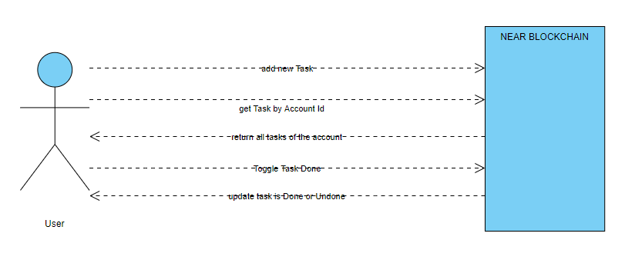
1. NEAR SMS TOOL
IDEA: TODO LIST – NEAR DAPP
Description: The small tool to store Todo lists on Blockchain using near protocol
Source code: https://github.com/vietnamforever/ToDo-List-Near-Dapp
Demo: http://huuthang.tech:1234

Slide 3
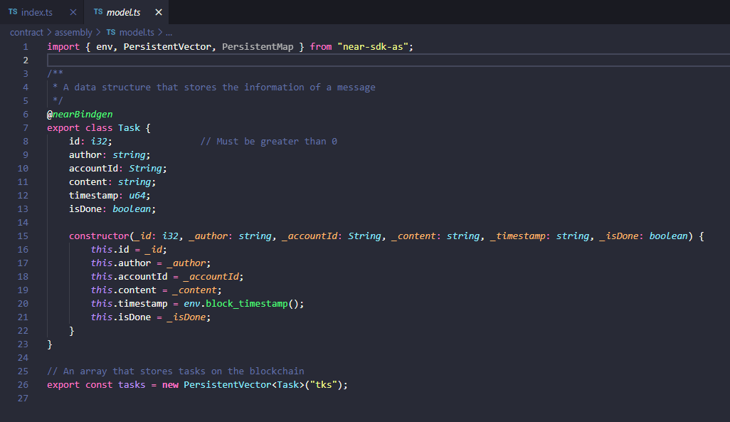
2. IMPLEMENTATION
MODEL.TS
Define Task data structure and declare variables to store data on NEAR blockchain.

Slide 4
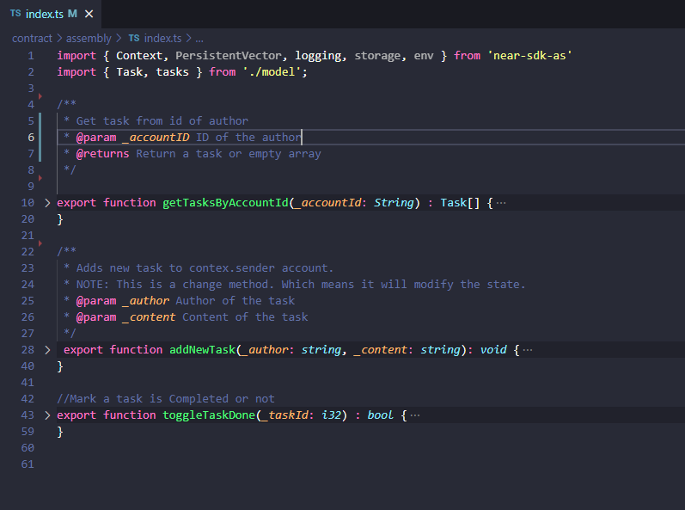
2. IMPLEMENTATION
INDEX.TS
Provide 3 functions to help clients manipulate data on Smart Contract

Slide 5
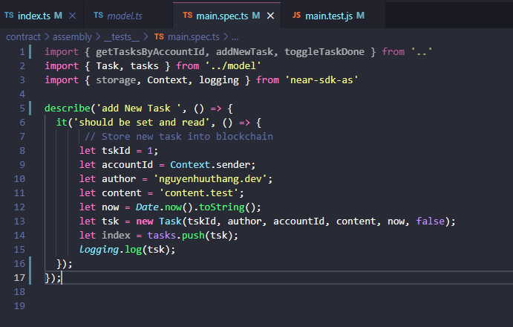
2. IMPLEMENTATION
TEST CASE

Slide 6
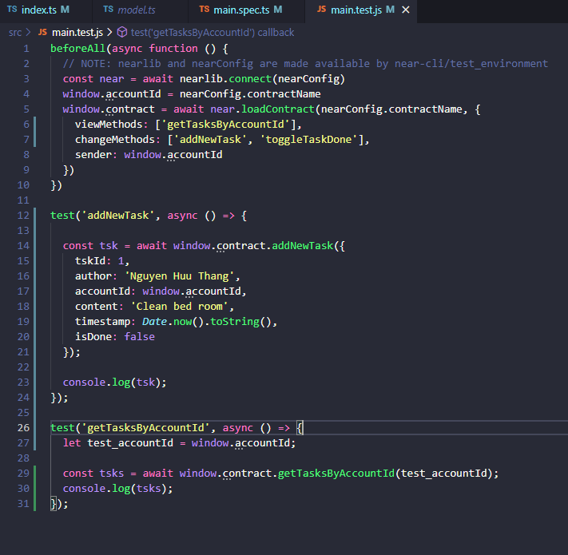
2. IMPLEMENTATION
TEST CASE

Slide 7
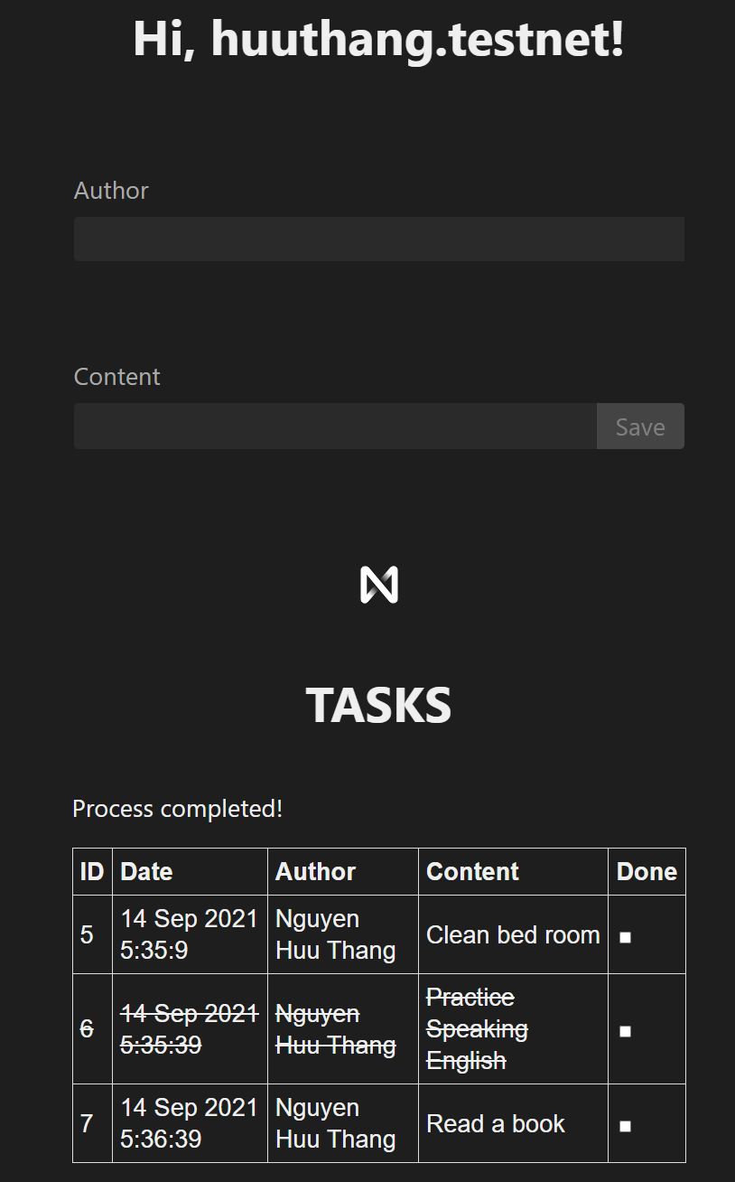
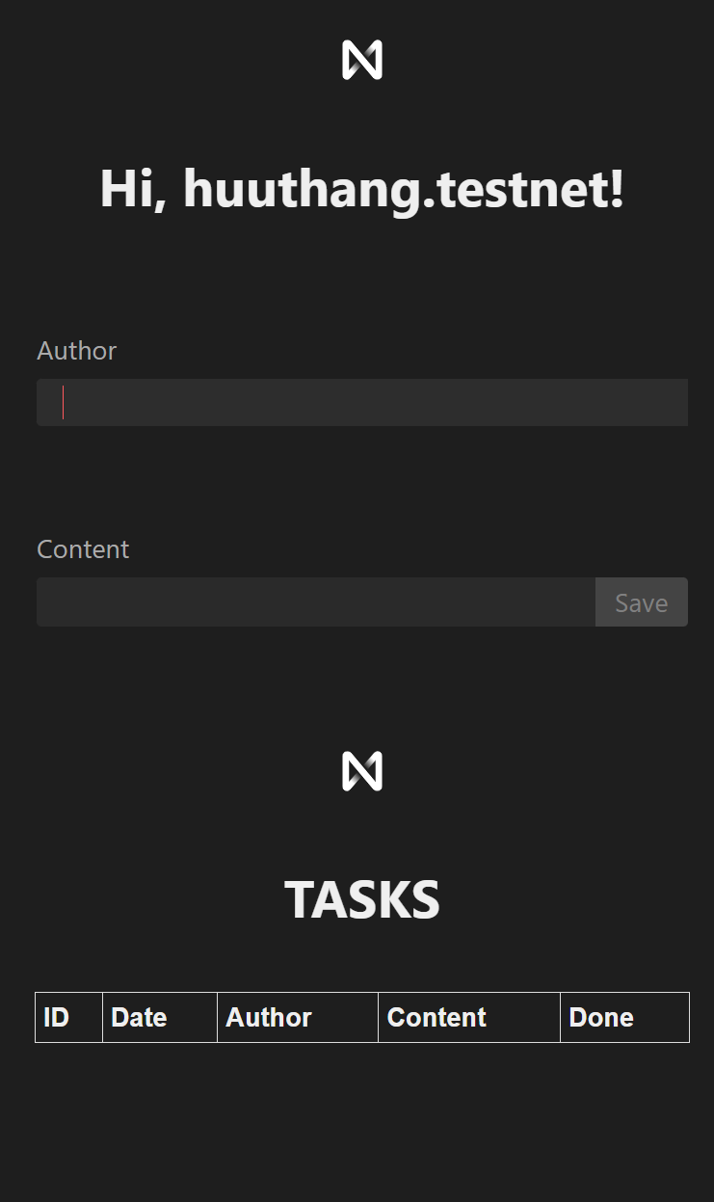
3. DEMO
Run Test
npm run test
Run Demo
npm run dev

Slide 8
4. DISCUSSION
WHAT NEEDS IMPROVEMENT?
  Need to add start and end time for each Task
FUTURE EXPECTATIONS?
  Can create the Todo list app with Image and sound on Todo List
    Support multimedia content as Image, Sound, Clip
    Support data size to several tens of MB of data
  The solutions:
    Content is store on IPFS encrypted with a symmetric key
    NEAR blockchain only store header data and a symmetric key encrypted public key.

Slide 9
Thank you for listening

